Slide 1
Programmable Logic Controllers (PLCs)

Slide 2
Programmable Logic Controllers (PLC’s)
A programmable logic controller (PLC) is a special purpose computer aimed at implementing control solutions.
Historically PLC’s have been used mainly for on-off or logic type applications.
However, modern PLC’s have become increasingly sophisticated and can now cover quite complex control tasks.

Slide 3
Industrial Robustness of PLC’s
It is common in the mining industry to have PLC’s on large mobile equipment to monitor and control everything from lights to large electrical drives.
The vibration and operating temperature of this environment require the use of specialized control equipment such as PLC’s.

Slide 4
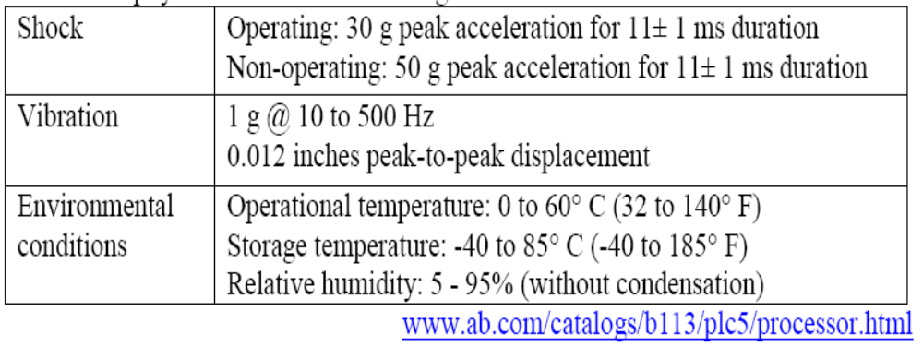
Some Physical Tolerances of leading
PLC brands

Slide 5
Leading Brands Of PLC
AMERICAN 1. Allen Bradley
2. Gould Modicon
3. Texas Instruments
4. General Electric
5. Westinghouse
6. Cutter Hammer
7. Square D
EUROPEAN 1. Siemens
2. Klockner & Mouller
3. Festo
4. Telemechanique

Slide 6
Leading Brands Of PLC
JAPANESE 1. Toshiba
2. Omron
3. Fanuc
4. Mitsubishi

Slide 7
PLC Size
1. SMALL - it covers units with up to 128 I/O’s and memories up to 2 Kbytes.
- these PLC’s are capable of providing simple to advance levels or machine controls.
2. MEDIUM - have up to 2048 I/O’s and memories up to 32 Kbytes.
3. LARGE - the most sophisticated units of the PLC family. They have up to 8192 I/O’s and memories up to 750 Kbytes.
- can control individual production processes or entire plant.

Slide 8
Areas of Application
Manufacturing / Machining
Food / Beverage
Metals
Power
Mining
Petrochemical / Chemical

Slide 9
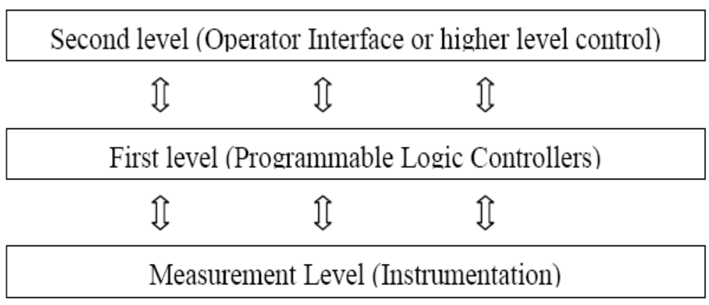
Control hierarchy of PLC’s

Slide 10
Major Components of a Common PLC
POWER
SUPPLY
I M
N O
P D
U U
T L
E
O M
U O
T D
P U
U L
T E
PROCESSOR
From SENSORS
To
OUTPUT
Pushbuttons,
contacts,
limit switches,
etc.
Solenoids, contactors, alarms
etc.
PROGRAMMING DEVICE

Slide 11
Major Components of a Common PLC
POWER SUPPLY
Provides the voltage needed to run the primary PLC components
I/O MODULES
Provides signal conversion and isolation between the internal logic-level signals inside the PLC and the field’s high level signal.

Slide 12
Major Components of a Common PLC
PROCESSOR
Provides intelligence to command and govern the activities of the entire PLC systems.
PROGRAMMING DEVICE
used to enter the desired program that will determine the sequence of operation and control of process equipment or driven machine.

Slide 13
Programming Device
Also known as:
Industrial Terminal ( Allen Bradley )
Program Development Terminal ( General Electric )
Programming Panel ( Gould Modicon )
Programmer ( Square D )
Program Loader ( Idec-Izumi )
Programming Console ( Keyence / Omron )

Slide 14
Programming Device
    Types:
    Hand held unit with LED / LCD display
    Desktop type with a CRT display
    Compatible computer terminal

Slide 15
I/O Module
The I/O interface section of a PLC connects it to external field devices.
The main purpose of the I/O interface is to condition the various signals received from or sent to the external input and output devices.
Input modules converts signals from discrete or analog input devices to logic levels acceptable to PLC’s processor.
Output modules converts signal from the processor to levels capable of driving the connected discrete or analog output devices.

Slide 16
I/O Module
DC INPUT MODULE
IS NEEDED TO:
Prevent voltage transients from damaging the processor.
Helps reduce the effects of electrical noise
USE TO DROP THE VOLTAGE TO LOGIC LEVEL
Current
Limiting
Resistor
Buffer, Filter, hysteresis Circuits
FROM INPUT
DEVICE
OPTO-
ISOLATOR
TO
PROCESSOR

Slide 17
I/O Module
AC INPUT MODULE
IS NEEDED TO:
Prevent voltage transients from damaging the processor.
Helps reduce the effects of electrical noise
CONVERTS THE AC INPUT TO DC AND DROPS THE VOLTAGE TO LOGIC LEVEL
Rectifier,
Resistor
Network
Buffer, Filter, Hysteresis Circuits
FROM INPUT
DEVICE
OPTO-
ISOLATOR
TO
PROCESSOR

Slide 18
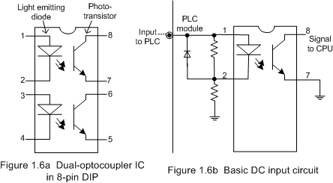

Slide 19
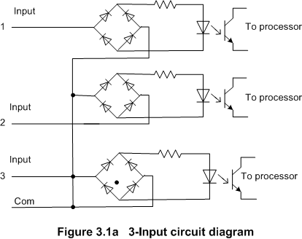

Slide 20
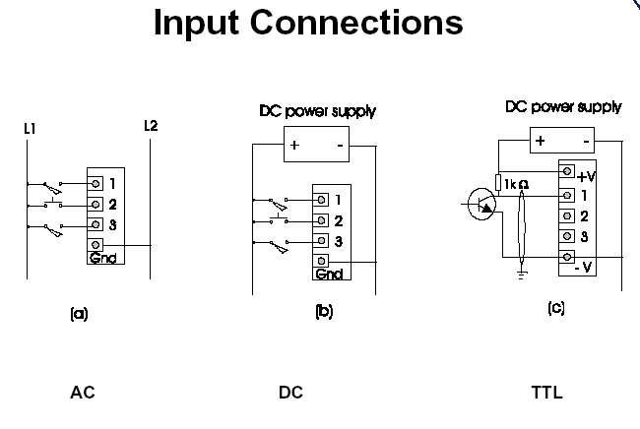

Slide 21
I/O Module
DC / AC OUTPUT MODULE
IS NEEDED TO:
Prevent voltage transients from damaging the processor.
Helps reduce the effects of electrical noise
Amplifier
RELAY
TRIAC
X’SISTOR
FROM PROCESSOR
TTL
Circuits
OPTO-
ISOLATOR
TO
OUTPUT
DEVICE

Slide 22
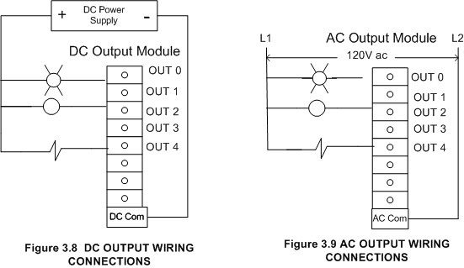

Slide 23
I/O Circuits
DIFFERENT TYPES OF I/O CIRCUITS
1. Pilot Duty Outputs
Outputs of this type typically are used to drive high-current electromagnetic loads such as solenoids, relays, valves, and motor starters.
These loads are highly inductive and exhibit a large inrush current.
Pilot duty outputs should be capable of withstanding an inrush current of 10 times the rated load for a short period of time without failure.

Slide 24
I/O Circuits
2. General - Purpose Outputs
These are usually low- voltage and low-current and are used to drive indicating lights and other non-inductive loads. Noise suppression may or may not be included on this types of modules.
3. Discrete Inputs
Circuits of this type are used to sense the status of limit switches, push buttons, and other discrete sensors. Noise suppression is of great importance in preventing false indication of inputs turning on or off because of noise.

Slide 25
I/O Circuits
4. Analog I/O
Circuits of this type sense or drive analog signals.
Analog inputs come from devices, such as thermocouples, strain gages, or pressure sensors, that provide a signal voltage or current that is derived from the process variable.
Standard Analog Input signals: 4-20mA; 0-10V
Analog outputs can be used to drive devices such as voltmeters, X-Y recorders, servomotor drives, and valves through the use of transducers.
Standard Analog Output signals: 4-20mA; 0-5V; 0-10V

Slide 26
Analog Inputs/Outputs (I/O)
  A signal of 4.0mA equates to zero,
  A signal of 20mA equates to 2048 for an 11 bit input.
The reason for the 4.0mA starting point is a fail-safe feature, if the instrument fails or the signal cable is damaged the current falls to zero and the PLC can alarm the operating system of the failure immediately.
This fail-safe feature is not possible for voltage signals which pass through zero volts.

Slide 27
I/O Circuits
5. Special - Purpose I/O
Circuits of this type are used to interface PLCs to very specific types of circuits such as servomotors, stepping motors, PID (proportional plus integral plus derivative) loops, high-speed pulse counting, resolver and decoder inputs, multiplexed displays, and keyboards.

Slide 28

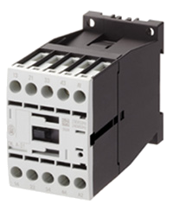
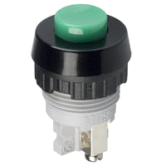


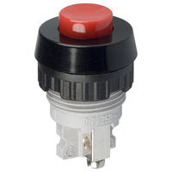
PLC with Inputs and Outputs
OUTPUTS
INPUTS
MOTOR
CONTACTOR
LAMP
PUSHBUTTONS
PLC

Slide 29
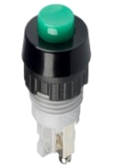
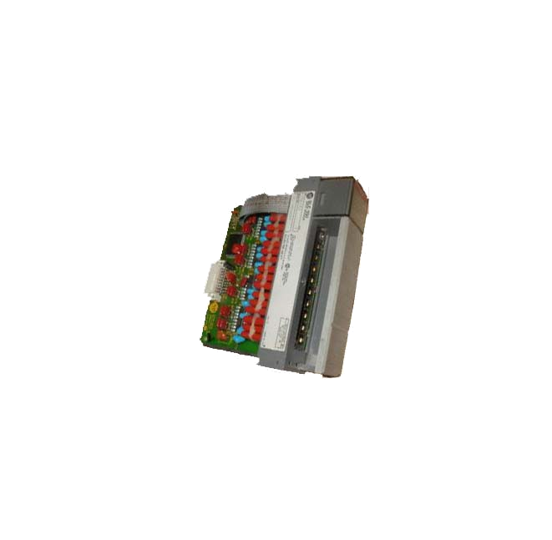
PLC with Inputs and Outputs
Allen-Bradley 1746-1A16
L1
L2
I= Input
Module
slot # in rack
I:2
P. B SWITCH
0
Module
Terminal #
Address I:2.0/0
LADDER PROGRAM
INPUT MODULE
WIRING DIAGRAM

Slide 30
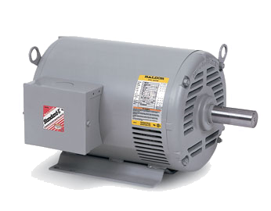

CONTACTOR
L2
L1
N.O
MOTOR
L2
C
L1
SOLENOID
VALVES
LAMP
BUZZER
FIELD WIRING
OUTPUT MODULE
WIRING
L1
O:4
L2
CONTACTOR
0
LADDER PROGRAM

Slide 31
Digital (Discrete) Input
A digital input is an input that is either ON or OFF are connected to the PLC digital input. In the ON condition it is referred to as logic 1 or a logic high and in the OFF condition maybe referred to as logic o or logic low.
Normally Open Pushbutton
Normally Closed Pushbutton
Normally Open switch
Normally Closed switch
Normally Open contact
Normally closed contact

Slide 32

Representation of switch
IN
OFF
Logic 0
PLC
Input
Module
24 V dc
IN
OFF
Logic 1
PLC
Input
Module
24 V dc

Slide 33
Processor
The processor module contains the PLC’s microprocessor, its supporting circuitry, and its memory system.
The main function of the microprocessor is to analyze data coming from field sensors through input modules, make decisions based on the user’s defined control program and return signal back through output modules to the field devices.
Field sensors: switches, flow, level, pressure, temp. transmitters, etc.
Field output devices: motors, valves, solenoids, lamps, or audible devices.
The memory system in the processor module has two parts: a system memory and an application memory.

Slide 34
Memory Map Organization
System memory includes an area called the EXECUTIVE, composed of permanently-stored programs that direct all system activities, such as execution of the users control program, communication with peripheral devices, and other system activities.
The system memory also contains the routines that implement the PLC’s instruction set, which is composed of specific control functions such as logic, sequencing, timing, counting, and arithmetic.
System memory is generally built from read-only memory devices.
SYSTEM
APPLICATION
The application memory is divided into the data table area and user program area.
The data table stores any data associated with the user’s control program, such as system input and output status data, and any stored constants, variables, or preset values. The data table is where data is monitored, manipulated, and changed for control purposes.
The user program area is where the programmed instructions entered by the user are stored as an application control program.
Data Table
User Program

Slide 35
Memory Designs
VOLATILE.
A volatile memory is one that loses its stored information when power is removed.
Even momentary losses of power will erase any information stored or programmed on a volatile memory chip.
Common Type of Volatile Memory
RAM. Random Access Memory(Read/Write)
Read/write indicates that the information stored in the memory can be retrieved or read, while write indicates that the user can program or write information into the memory.

Slide 36
Memory Designs
The words random access refer to the ability of any location (address) in the memory to be accessed or used. Ram memory is used for both the user memory (ladder diagrams) and storage memory in many PLC’s.
RAM memory must have battery backup to retain or protect the stored program.

Slide 37
Memory Designs
NON-VOLATILE
Has the ability to retain stored information when power is removed, accidentally or intentionally. These memories do not require battery back-up.
Common Type of Non-Volatile Memory
ROM, Read Only Memory
Read only indicates that the information stored in memory can be read only and cannot be changed. Information in ROM is placed there by the manufacturer for the internal use and operation of the PLC.

Slide 38
Memory Designs
Other Types of Non-Volatile Memory
PROM, Programmable Read Only Memory
Allows initial and/or additional information to be written into the chip.
PROM may be written into only once after being received from the PLC manufacturer; programming is accomplish by pulses of current.
The current melts the fusible links in the device, preventing it from being reprogrammed. This type of memory is used to prevent unauthorized program changes.

Slide 39
Memory Designs
EPROM, Erasable Programmable Read Only Memory
Ideally suited when program storage is to be semi-permanent or additional security is needed to prevent unauthorized program changes.
The EPROM chip has a quartz window over a silicon material that contains the electronic integrated circuits. This window normally is covered by an opaque material, but when the opaque material is removed and the circuitry exposed to ultra violet light, the memory content can be erased.
The EPROM chip is also referred to as UVPROM.

Slide 40
Memory Designs
EEPROM, Electrically Erasable Programmable Read Only Memory
Also referred to as E²PROM, is a chip that can be programmed using a standard programming device and can be erased by the proper signal being applied to the erase pin.
EEPROM is used primarily as a non-volatile backup for the normal RAM memory. If the program in RAM is lost or erased, a copy of the program stored on an EEPROM chip can be down loaded into the RAM.

Slide 41
PLC Operation
Basic Function of a Typical PLC
Read all field input devices via the input interfaces, execute the user program stored in application memory, then, based on whatever control scheme has been programmed by the user, turn the field output devices on or off, or perform whatever control is necessary for the process application.
This process of sequentially reading the inputs, executing the program in memory, and updating the outputs is known as scanning.

Slide 42
While the PLC is running, the scanning process includes the following four phases, which are repeated continuously as individual cycles of operation:
PHASE 1
Read Inputs
Scan
PHASE 2
Program
Execution
PHASE 3
Diagnostics/
Comm
PHASE 4
Output
Scan

Slide 43
PHASE 1 – Input Status scan
    A PLC scan cycle begins with the CPU reading the status of its inputs.
PHASE 2– Logic Solve/Program Execution
    The application program is executed using the status of the inputs
PHASE 3– Logic Solve/Program Execution
    Once the program is executed, the CPU performs diagnostics and communication tasks
PHASE 4 - Output Status Scan
    An output status scan is then performed, whereby the stored output values are sent to actuators and other field output devices. The cycle ends by updating the outputs.

Slide 44
As soon as Phase 4 are completed, the entire cycle begins again with Phase 1 input scan.
The time it takes to implement a scan cycle is called SCAN TIME.
The scan time composed of the program scan time, which is the time required for solving the control program, and the I/O update time, or time required to read inputs and update outputs. The program scan time generally depends on the amount of memory taken by the control program and type of instructions used in the program.
The time to make a single scan can vary from 1 ms to 100 ms.

Slide 45
List of items required when working with PLCs:
    1. Programming Terminal - laptop or desktop PC.
    2. PLC Software. PLC manufacturers have
    their own specific software and license key.
    3. Communication cable for connection from Laptop to PLC.
    4. Backup copy of the ladder program (on diskette, CDROM, hard disk, flash memory). If none, upload it from the PLC.
    5. Documentation- (PLC manual, Software manual, drawings, ladder program printout, and Seq. of Operations manual.)

Slide 46
Examples of PLC Programming Software:
    1. Allen-Bradley – Rockwell Software RSLogix500
    2. Modicon - Modsoft
    3. Omron – Syswin, CX-Programme
    4. GE-Fanuc Series 6 – LogicMaster6
    5. Square D- PowerLogic
    6. Texas Instruments – Simatic
    6. Telemecanique – Modicon TSX Micro

Slide 47
PROGRAMMING
Normally Open
(NO)
Normally Closed
(NC)
Power flows through these contacts when they are closed. The normally open (NO) is true when the input or output status bit controlling the contact is 1. The normally closed (NC) is true when the input or output status bit controlling the contact is 0.

Slide 48
Coils
Coils represent relays that are energized when power flows to them. When a coil is energized it causes a corresponding output to turn on by changing the state of the status bit controlling the output to 1. That same output status bit maybe used to control normally open or normally closed contact anywhere in the program.

Slide 49
Boxes
Boxes represent various instructions or functions that are
Executed when power flows to the box. Some of these
Functions are timers, counters and math operations.

Slide 50
AND OPERATION
A
B
C
Rung
Each rung or network on a ladder program represents
a logic operation. In the rung above, both inputs A and B
must be true (1) in order for the output C to be true (1).

Slide 51
OR OPERATION
A
C
Rung
B
In the rung above, it can be seen that either input A or B
is be true (1), or both are true, then the output C is true (1).

Slide 52
NOT OPERATION
A
C
Rung
In the rung above, it can be seen that if input A is be true (1),
then the output C is true (0) or when A is (0), output C is 1.

Slide 53
Ladder Logic
Ladder logic is possibly the simplest programming language.
The principle behind the language is illustrated by a simple electrical relay. (Electrical relay logic preceded PLC’s as initially all logic was implemented in hard wired panels using actual relays, timer, Counters etc.)

Slide 54
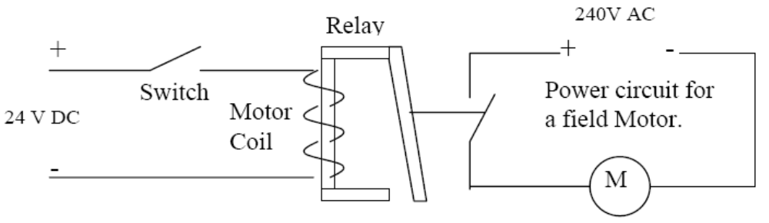
Simple Relay Circuit

Slide 55

Circuit representation in Ladder Logic
The above circuit is represented in Ladder logic as shown in figure below (only the low voltage circuit is used in ladder logic diagrams):

Slide 56
Boolean Logic
The above diagram can be expressed in Boolean logic “Motor Coil = Switch”, ie if the Switch is on the Motor coil is energized and Motor is activated.
All ladder logic takes the form of that shown in Figure above.
Thus it connects the positive and neutral rail representing positive and negative power supply to the relay.

Slide 57
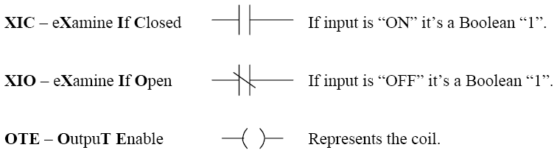
Ladder Logic Instructions
The three most common instructions in ladder logic are:

Slide 58
PLC Switching
The majority of simple PLC switching tasks can be implemented using these simple instructions.
However there exists a set of 60 to 100 individual instructions such as those above which form the complete PLC language.
Other functions vary from simple timers and counters to more sophisticated control functions such as PID controllers and advanced arithmetic functions.

Slide 59
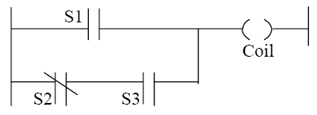
Multi Input/Output Rungs

Slide 60

Multi Input/Output Rungs
Each of the inputs in series such as ‘S2’ and ‘S3’ are equivalent to the Boolean “AND”{.} statement while a “Bridge” in a rung is seen as an “OR”{+} statement.
In the case shown in Figure above the Boolean expression for the Coil is:

Slide 61
Multi Output Rungs
It is also possible to have multi output rungs provided the OTE instructions are never placed is series, they must always be in parallel and in contact with the Neutral (right) rail, as shown in figure below. (While multi output rungs are necessary in some cases, it is often beneficial to divide the rung into several smaller rungs for the purpose of program clarity)

Slide 62
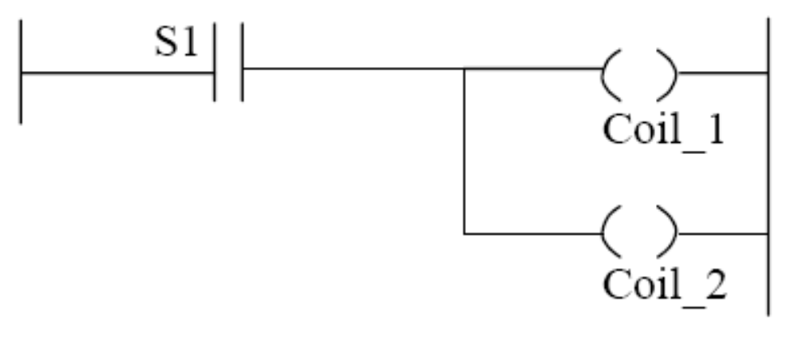
Multi Output Rungs

Slide 63
Start-Stop Rung
Any large rung can always be broken down into simple Boolean expressions such as for the simple rungs shown above.
Just as common electrical relays have auxiliary outputs, which are used for feedback and indication, a similar strategy is used in ladder logic.
To demonstrate this point a simple START/STOP rung is examined.
Two Push Buttons (PB) are used for the ‘start’ and ‘stop’ inputs (Push buttons return a High or Low signal to the PLC only for the duration during which the button is held down), Consider the logic shown in Figure below.

Slide 64
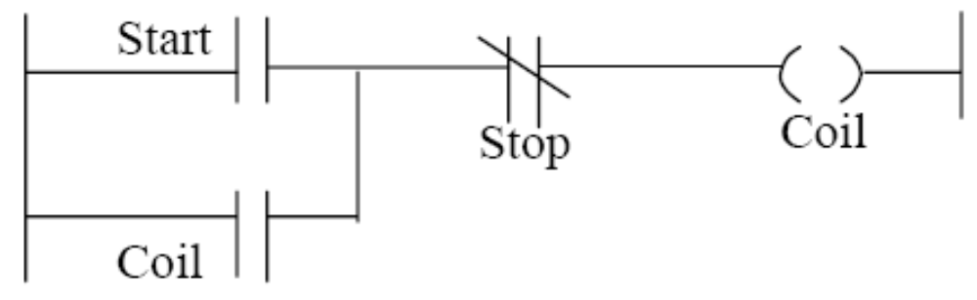
Use of Auxiliary Output

Slide 65
Push Button Example
In this case the push buttons are “normally open” i.e. they return a low signal in their normal position and a high signal when pressed.
Initially assume the Coil output is off, and the Push Buttons (PB) not activated so they are also off.
When the ‘Start PB’ is pressed the top path through the rung is satisfied with start = 1and stop = 0 so the coil is turned ON.
Note this also satisfies the bottom path through the rung on the next scan since coil = 1 and stop = 0.
When the start button is released the top path through the rung becomes false but the rung is still satisfied by the bottom path, ie the coil remains on after the start PB is released.

Slide 66
Push Button Example
Pressing the ‘stop’ button (stop =1) breaks the rung so the coil is turned OFF and remains off after the stop button is released.

Slide 67
Commercially Available PLC’s

Slide 68
Allen-Bradley PLC’s
Below are AB PlCs
Note that AB is part of the Rockwell Automation, a global leading Automation giant.

Slide 69
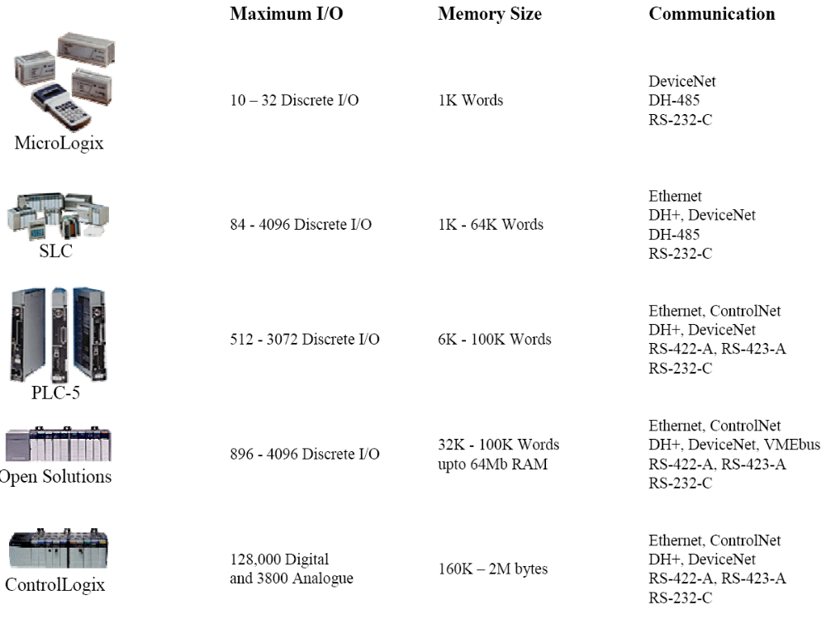
Eng. R. L. Nkumbwa @ CBU 2010

Slide 70
Siemens Simatic PLC’s

Slide 71
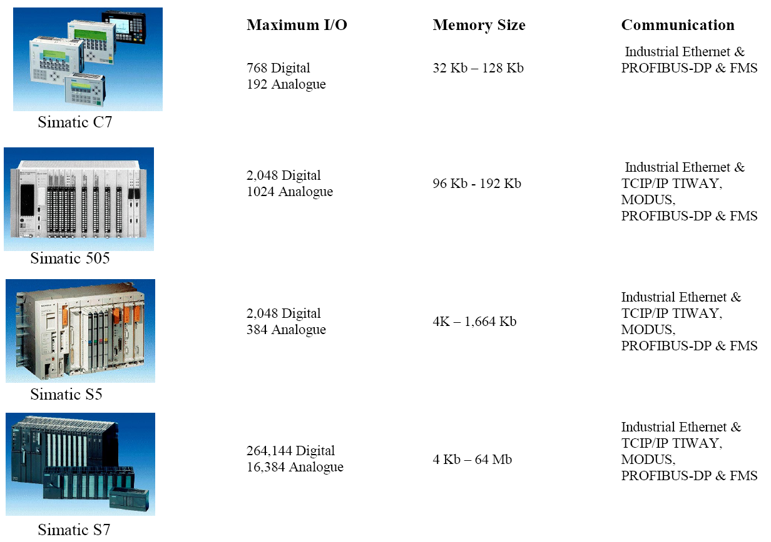
Eng. R. L. Nkumbwa @ CBU 2010

Slide 72
Modicon TSX PLC’s

Slide 73
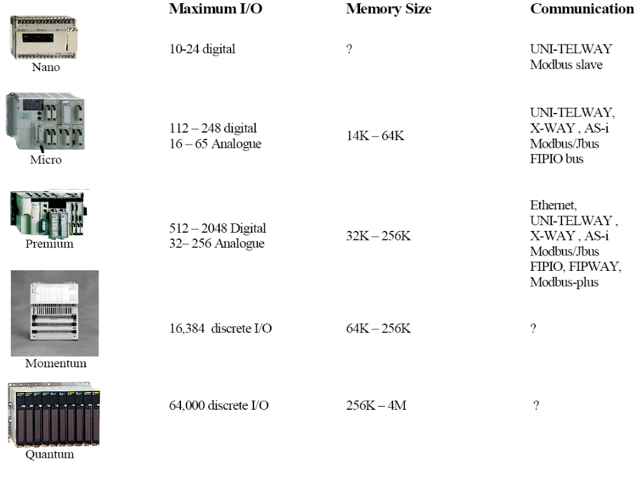
Eng. R. L. Nkumbwa @ CBU 2010

Slide 74
Other PLC Terminology
On-line: Refers to the program code currently in the PLC memory.
Off-line: Refers to the copy of the program code stored on the programming computer.
Up-Load: Refers to the act of copying the current On-line code from the PLC to the programming computer . (Note the previous code on the programming computer is lost during this transfer if a copy is not made)
Down-Load: Refers to the act of copying the code from the programming computer into the PLC’s memory. (note the previous PLC code is lost during this transfer).
Note: It is important to realize that changing the On-line program will not change the Off-line program on the programming computer. Invariably at the end of any edit there must follow an Up-load or Down-Load to make the Online and Off-line programs the same.

Slide 75
Other PLC Terminology
Run Mode: The PLC actively scanning the code and driving outputs.
Program Mode: The PLC is not being scanned (All outputs disabled)
Remote Mode: programming computer can change the PLC between Run and Program.
Note: There is a physical key on the front of each PLC processor module, which allows the PLC to be switched between Run, Remote and Program Mode.

Slide 76
Programming Procedure
PLC’s are very versatile in the respect that programming changes can be made on-line while the processor is in Run Mode.
This is equivalent to making changes in a compiled ‘C’ program while it is being executed.
To introduce programming edits into the existing code while in Run Mode the following procedure is followed.

Slide 77
Programming Procedure
Insert edit rungs into the On-line PLC code (as many changes as required). These edits are effectively invisible to the processor during this stage.
Once all edit rungs are entered switch the processor to TEST, during TEST mode any new inserted code is allowed to be scanned along with existing code, if any code is marked for deletion this code is prevented from being scanned at this stage.
Once you are confident that the edit rungs are correct Assemble the code which permanently activates new code and permanently removes any code marked for deletion.

Slide 78

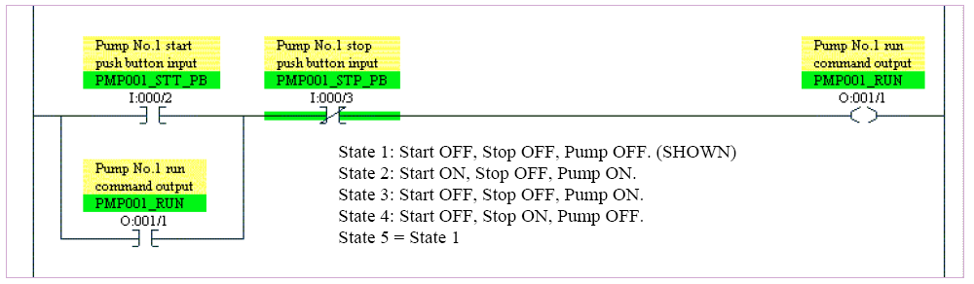
Programming Example:
Simple start/stop ladder logic.
Eng. R. L. Nkumbwa @ CBU 2010

Slide 79
Programming Example:
Simple start/stop ladder logic.
This is as it would appear in a windows based programming package.
Text in the Yellow and Green box’s is the Address Description and Address Symbol respectively.
The symbols often correspond to SCADA (System Control and Data Acquisition) software tags.

Slide 80
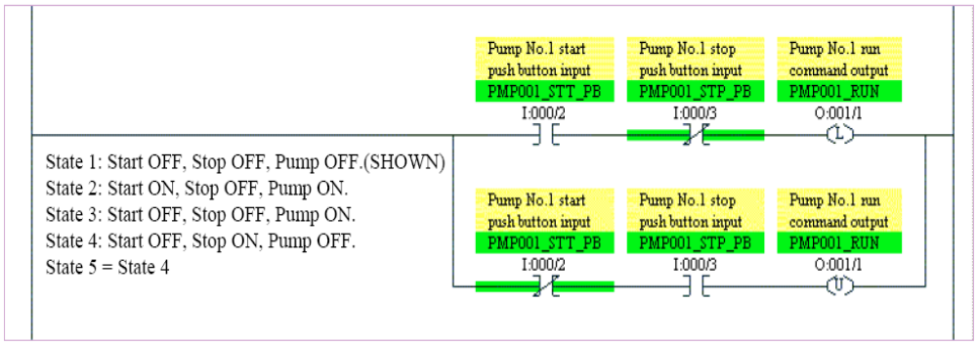
Alternative Start/Stop using
Latch and Unlatch instructions.

Slide 81
PLC Communications
Common Uses of PLC Communications Ports
Changing resident PLC programs - uploading/downloading from a supervisory controller (Laptop or desktop computer).
Forcing I/O points and memory elements from a remote terminal.
Linking a PLC into a control hierarchy containing several sizes of PLC and computer.
Monitoring data and alarms, etc. via printers or Operator Interface Units (OIUs).

Slide 82
PLC Communications
Serial Communications
PLC communications facilities normally provides serial transmission of information.
Common Standards
RS 232
Used in short-distance computer communications, with the majority of computer hardware and peripherals.
Has a maximum effective distance of approx. 30 m at 9600 baud.

Slide 83
PLC Communications
Local Area Network (LAN)
Local Area Network provides a physical link between all devices plus providing overall data exchange management or protocol, ensuring that each device can “talk” to other machines and understand data received from them.
LANs provide the common, high-speed data communications bus which interconnects any or all devices within the local area.
LANs are commonly used in business applications to allow several users to share costly software packages and peripheral equipment such as printers and hard disk storage.

Slide 84
PLC Communications
RS 422 / RS 485
Used for longer-distance links, often between several PCs in a distributed system. RS 485 can have a maximum distance of about 1000 meters.

Slide 85
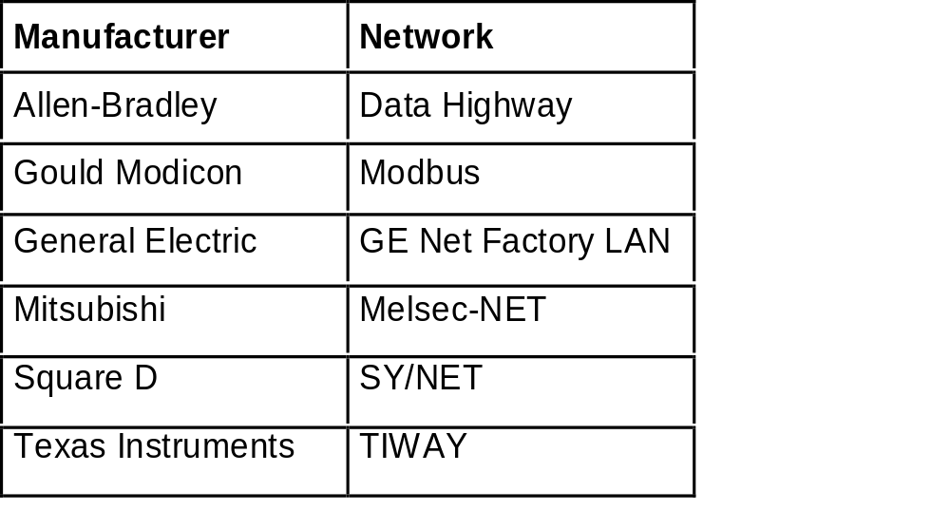
PLC Communications
Programmable Controllers and Networks
Dedicated Network System of Different Manufacturers

Slide 86
Specifications
Several factors are used for evaluating the quality and performance of programmable controllers when selecting a unit for a particular application. These are listed below.
NUMBER OF I /O PORTS
This specifies the number of I/O devices that can be connected to the controller. There should be sufficient I/O ports to meet present requirements with enough spares to provide for moderate future expansion.

Slide 87
Selecting a PLC
    Criteria
    • Number of logical inputs and outputs.
    • Memory
    • Number of special I/O modules
    • Scan Time
    • Communications
    • Software

Slide 88
A Detailed Design Process
  1. Understand the process
  2. Hardware/software selection
  3. Develop ladder logic
  4. Determine scan times and memory requirements

Slide 89
Specifications
OUTPUT-PORT POWER RATINGS
Each output port should be capable of supplying sufficient voltage and current to drive the output peripheral connected to it.
SCAN TIME
This is the speed at which the controller executes the relay-ladder logic program. This variable is usually specified as the scan time per 1000 logic nodes and typically ranges from 1 to 200 milliseconds.

Slide 90
Specifications
MEMORY CAPACITY
The amount of memory required for a particular application is related to the length of the program and the complexity of the control system. Simple applications having just a few relays do not require significant amount of memory. Program length tend to expand after the system have been used for a while. It is advantageous to a acquire a controller that has more memory than is presently needed.

Slide 91
PLC Status Indicators
Power On
Run Mode
Programming Mode
Fault

Slide 92
Troubleshooting
    1. Look at the process
    2. PLC status lights
      HALT - something has stopped the CPU
      RUN - the PLC thinks it is OK (and probably is)
      ERROR - a physical problem has occurred with the PLC
    3. Indicator lights on I/O cards and sensors
    4. Consult the manuals, or use software if available.
    5. Use programming terminal / laptop.

